Slide 1


Key takeaways from my Internship
During my internship, I gained hands-on experience in web development, deepening my understanding of HTML, CSS, and JavaScript. With these skills a I created a small webpage Climate-Cast.
by S Lalithaditya (22A91A05F9)
A

Slide 2

HTML: Structure and Markup
Semantic Elements
Accessibility
Forms and Validation
Learned to use semantic HTML tags like header, nav, main, and footer to create a well-organized document structure.
Understood the importance of accessibility and how to use alt text, ARIA roles, and other techniques to make web content inclusive.
Explored HTML form elements and client-side validation to improve user experience and data integrity.

Slide 3




CSS: Styling and Design
Responsive Design
Learned to use CSS media queries to create layouts that adapt to different screen sizes and devices.
Typography
Explored the art of typography, including font families, sizes, and spacing to enhance the visual appeal of web pages.
Animations
Discovered how to use CSS transitions and animations to add subtle, yet impactful, effects to the user interface.

Slide 4




JS: Interactivity and Functionality
DOM Manipulation
Event Handling
Asynchronous Behavior
Learned to use JavaScript to select, modify, and interact with HTML elements on the page.
Explored how to listen for and respond to user interactions, such as clicks, hovers, and form submissions.
Gained experience with async/await and promises to handle asynchronous operations, like API calls, without blocking the main thread.

Slide 5


Climate Cast
I created a vibrant, interactive weather application that engages users! Using HTML, CSS, and JavaScript, I built a tool that provides real-time updates and enhances the overall experience. This app helps users stay informed about changing forecasts and plan their day with confidence!

Slide 6
Responsive HTML Structure
Card Layout
Search Functionality
Dynamic Elements
The core of the weather app is a visually appealing card that displays the essential weather information.
Users can easily find the weather for their desired location using a search bar integrated into the app.
Weather icons, temperature, city name, and details like humidity and wind speed are dynamically updated based on the API response.

Slide 7
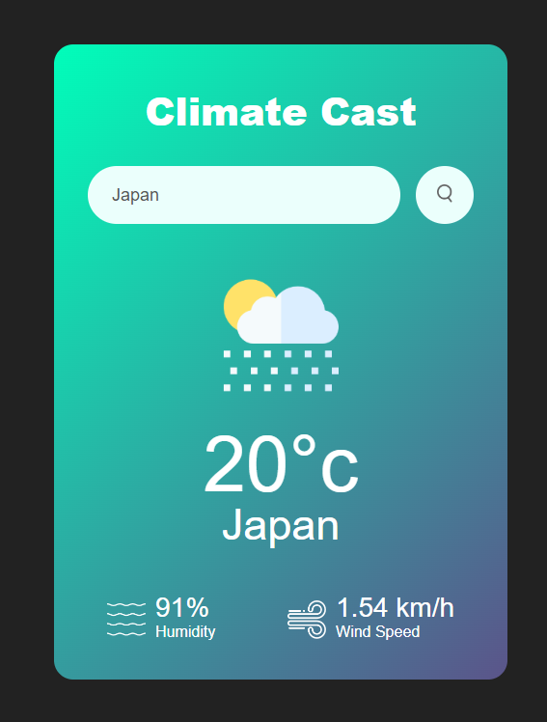



JavaScript Interactions
API Integration
The app fetches weather data from the OpenWeatherMap API, providing accurate and up-to-date information.
Data Parsing
The JSON response is parsed to extract the relevant weather data, which is then used to update the UI.
Dynamic Updates
JavaScript seamlessly updates the HTML elements with the fetched weather data, creating a responsive and engaging experience.

Slide 8


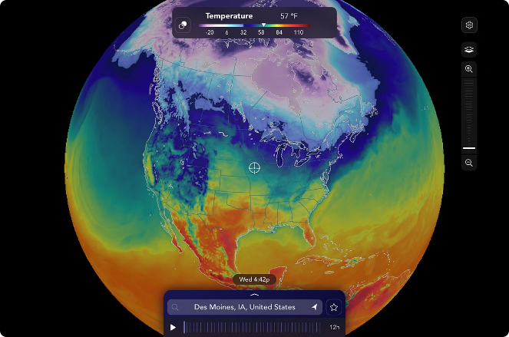



Weather Data Visualization
Weather Icon
A dynamic weather icon reflects the current weather conditions, enhancing the user's understanding at a glance.
Temperature
The temperature is prominently displayed, allowing users to quickly assess the current weather.
Humidity
The humidity level is provided, giving users additional context about the current atmospheric conditions.
Wind Speed
The wind speed is shown, informing users about the potential impact on their outdoor activities.

Slide 9

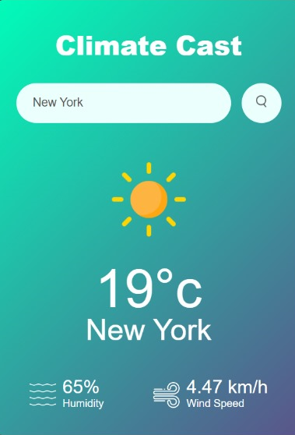
Event-Driven Functionality
1
Search Input
Users can enter a city name in the search bar to retrieve the corresponding weather information.
2
Button Click
Clicking the search button triggers the JavaScript function to fetch the weather data.
3
Data Update
The app's HTML elements are dynamically updated with the retrieved weather data, providing an instant response to the user's input.

Slide 10

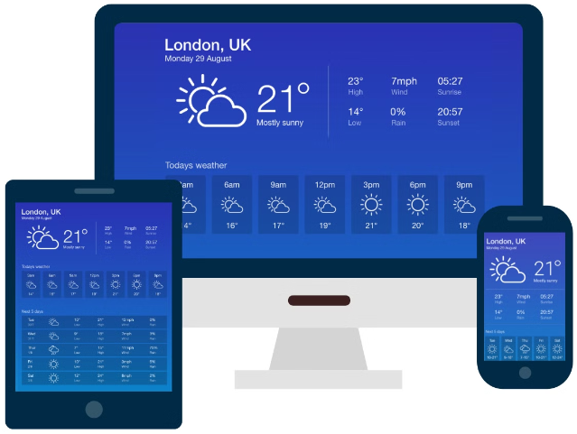
Conclusion: A Weather App for the Modern Web
By combining the power of HTML, CSS, and JavaScript, you can create a dynamic and engaging weather application that provides users with real-time weather information. This weather app showcases the potential of the modern web, delivering a responsive and interactive experience across a range of devices.
To learn more about Climate Cast or to get started, visit https://sladitya.github.io/internship/

